Slide 1


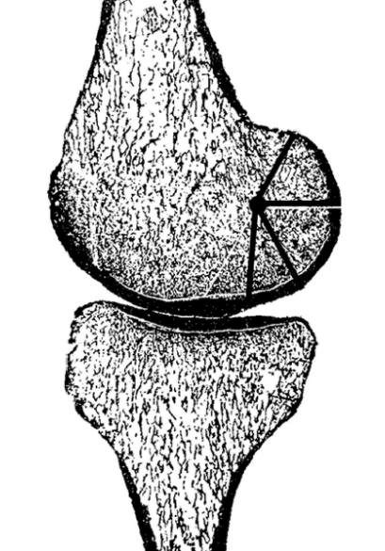
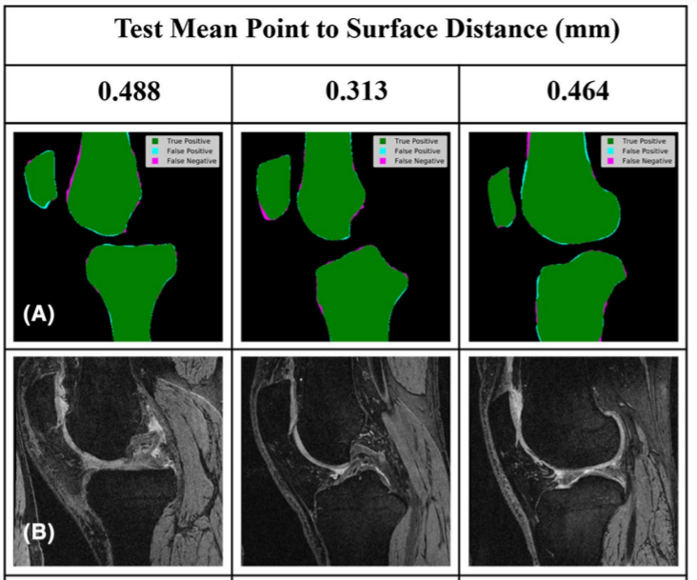
Radius of Medial Vs. Lateral Femoral Condyle: An analysis of 6,289 MRIs with Machine Learning
Romil Shah, MD², Stefano Bini, MD¹; Thomas Vail, MD¹
¹University of California, San Francisco Department of Orthopedic Surgery
²University of Texas, Austin Department of Orthopedic Surgery
INTRODUCTION
Machine Learning and the OAI
METHODS
New designs and techniques are being implemented to improve the anatomic alignment of the total knee replacement
  Computer guidance
  Robotics, Navigation Based Tools
  Personalized Cutting Guides
Understanding the bony surface anatomy of the distal femur and its relationship to the rotational axis of the knee may be important in restoring normal knee kinematics in TKA
New machine learning techniques allow us to do analysis on thousands of knee MRIs. Can we use these techniques to help better understand distal femur surface anatomy?
Osteoarthritis Initiative
A database of 4,769 patients with their demographic information knee radiographs
Novel machine learning algorithm used which
segments bone, cartilage, and meniscus tissue types
out of an MRI image for easy analysis of bone
volume and measurements of a bone surface
Patient Characteristics
  6,829 knees included in the study.
  Average age of 61, Average BMI of 29
  89% had varus patterns and 85% had a KL score of 0, 1, or 2
Variables Calculated with our Algorithm
  Patient MRIs fed into
  machine learning algorithm for
  segmentation.
  Medial and Lateral femoral
  condyle radius calculated
  Varus vs. valgus wear pattern
  Calculated
  Statistical Analysis
  Average condyle size calculated for each KL grade in varus and valgus knees
  Regression created to analyze influencing factors on differences between medial and lateral femoral condyles
Weber et al. Mechanik der menschlichen Gehwerkzeuge. Eine anatomisch-physiologische Untersuchung. G ̈ottingen, Germany: Dieterich; 1836.
RESULTS
DISCUSSION
 | Varus Patients |  |  |  | Valgus Patients
 | Medial Femoral Condyle Radius (mm) | Lateral Femoral Condyle Radius (mm) | Difference in size (mm) | P-Value | Medial Femoral Condyle Radius (mm) | Lateral Femoral Condyle Radius (mm) | Difference in size (mm) | P-Value
KL 0 (n=2,672) | 15.7 (7.5) | 16.4 (6.2) | 0.7 | p<0.001 | 14.3 (2.8) | 16.5 (6.7) | 2.2 | p<0.001
KL 1 (n=1,254) | 15.6 (6.5) | 16.5 (7.5) | 0.9 | p = 0.0021 | 15.1 (2.7) | 15.3 (2.6) | 0.2 | p = 0.46
KL 2 (n=1,794) | 14.7 (4.7) | 16.2 (7.5) | 1.5 | p<0.001 | 16.1 (9.4) | 18.2 (11.7) | 2.1 | p = 0.020
KL 3 (n=882) | 15.0 (8.2) | 17.1 (10.1) | 2.1 | p<0.001 | 13.7 (3.1) | 20.9 (19.1) | 7.2 | p<0.001
KL 4 (n=227) | 16.4 (12.2) | 23.1 (21.6) | 6.7 | p<0.001 | 14.3 (6.8) | 19.5 (14.3) | 5.2 | p = 0.024
Our study of over 6,800 patients demonstrates that the femoral condyles are roughly the same size and that where there is a difference, the lateral femoral condyle is the larger of the two condyles
We found an association between advanced osteoarthritis and a greater mismatch in condylar radius (lateral condylar radius is larger than the medial one as arthritis progressed)
The general misperception that the lateral femoral condyle is smaller than the medial may not be anatomically based but rather caused by the arbitrary realignment of the joint line into a fixed, non-anatomic position subjectively aligned to the patient’s mechanical axis that differs from their native alignment, regardless of the arthritic state of the knee
Multivariable Regression Results
After adjusting for age, BMI, and sex, patients with a valgus wear pattern and patients with greater KL scores had a larger difference in radius between their lateral and medial condyle (p=0.003, p <0.001, respectively

